Slide 1

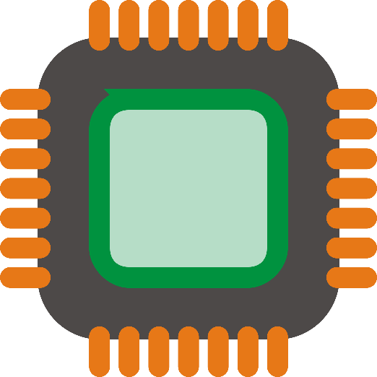
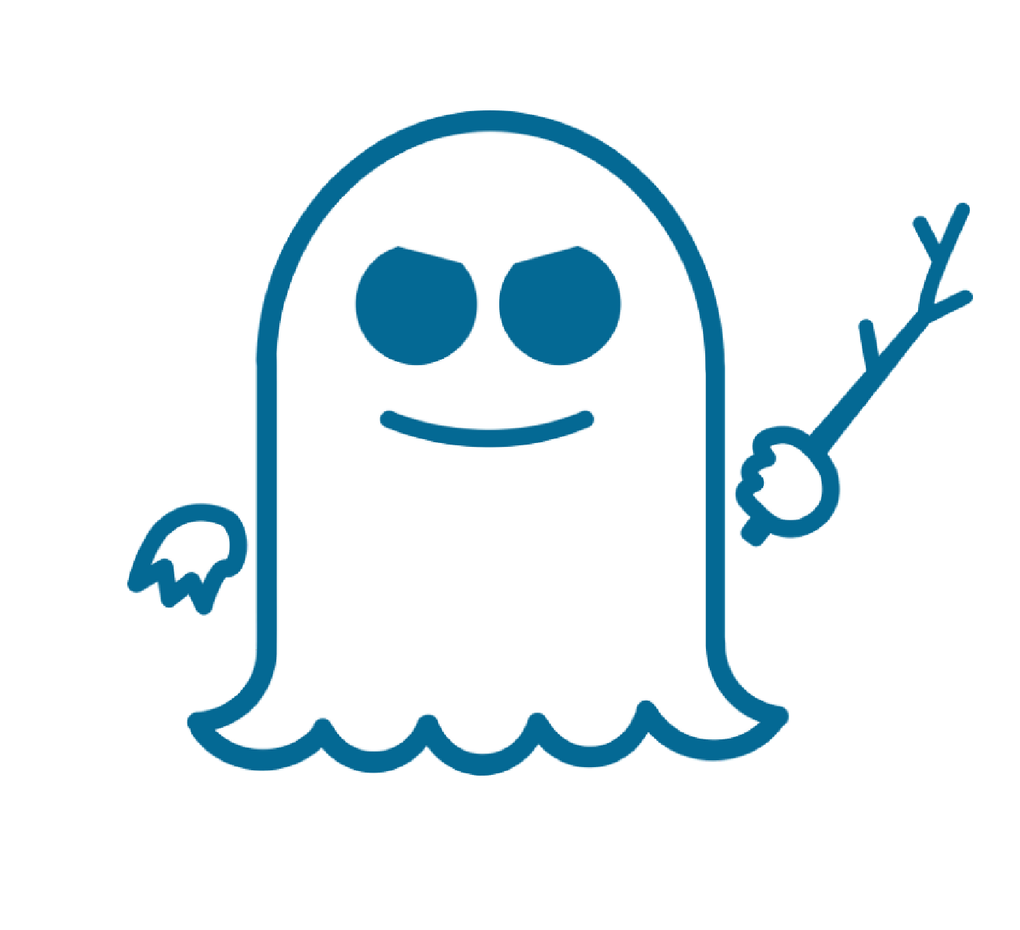
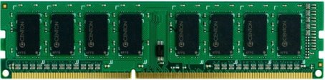

Do Not Forget Hardware Prefetchers While Mitigating Spectre Attacks
Sumon Nath (MS 2nd year) Adviser: Biswabandan Panda (IIT Bombay)
CASPER
Executive Summary
The Spectre Attack [S&P, 2019]
Transient attacks (Spectre, Meltdown) are here to stay
Why?: Transient instructions get squashed by processor, but data brought by the transient instructions are in the cache
Solution: Do not cache the data of transient instructions
Problem: What about hardware prefetchers?
Solution: Designing Secure Prefetchers not at the cost of performance
Train and trigger hardware prefetching only for safe instructions
If (x < array1_size)
y = array2[array1[x]]
Mistrains
branch predictor
Cache
Victim code
49
129
Invokes victim with out-of-bound x = 19
Secret key = array1[x] = 49
Attacker measures which location of array2 was brought into cache
array2[49]
State-of-the-art solution [MICRO 2021]
Hardware Prefetcher-101
What does GM say?
Stores all speculative data
Writeback to L1D on commit
Wiped on context switch
Strictness ordering
DRAM
HIT
Prefetch on commit ☹
Prefetch speculatively to GM cache ☺
Wiped on context switch ☹
Is it good enough in terms of performance?
LLC
X + 3
X + 3
3
CORE
5
Cache
L2
data
4
Time guarding
Free slotting
Leap frogging
PF?
L1D
GM
X + 2
X + 1
X
1
X + 3
CPU
Prefetcher
2
GhostMinion(GM) cache
Scan to download
Big deal
Ongoing work
References
SPEC 2017 workloads
Revisiting state-of-the-art prefetchers keeping performance and security in mind
Prefetcher should be at the GM cache or L1 cache?
How to trigger prefetcher on commit and provide same performance as the non-secure baseline?
Can we train prefetchers speculatively and still provide security guarantee?
[1] P. Kocher, et al. "Spectre attacks: Exploiting speculative execution." S&P 2019
[2] S. Pakalapati, and B. Panda "Bouquet of instruction pointers: Instruction pointer classifier-based spatial hardware prefetching." ISCA 2020
[3] S. Ainsworth "GhostMinion:
A strictness-ordered cache system for spectre mitigation." MICRO 2021
[4] A. Navarro-Torres, et al. "Berti:
an Accurate Local-Delta Data Prefetcher." MICRO 2022
20 to 50% performance degradation ☹
Intel improves performance/year by 2% ☹ ☹

